Slide 1
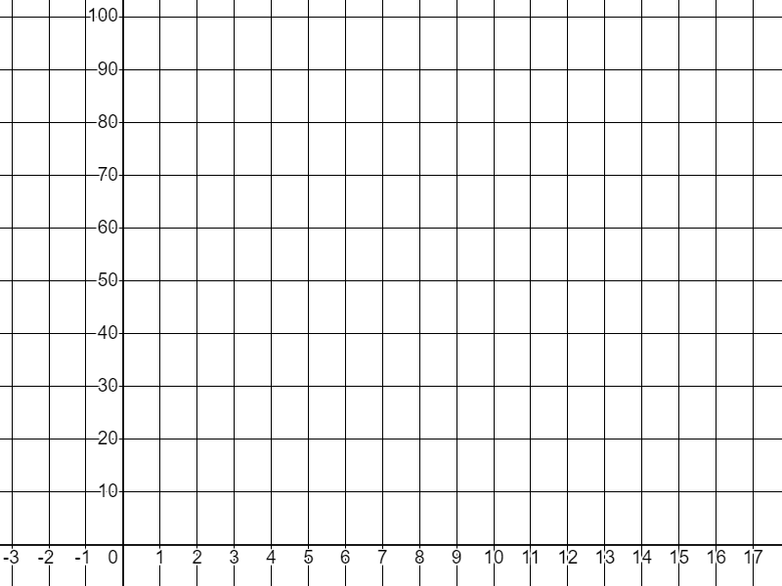
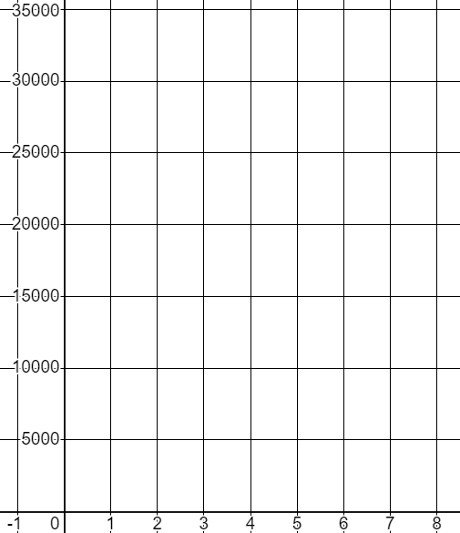
Representing geometric sequences graphically
Task A: Graphing a common ratio greater than 1
1) Fill in the table of values and plot the geometric sequence that starts on 1 and has a common ratio of 3
T
Term number (n) | 1 | 2 | 3 | 4 | 5
Term value (T)
n
2) You invest £2000 in a new tech company and your shares grow in value by 50% each year. Calculate their value for the first 8 years and plot it on the graph.
t | 1 | 2 | 3 | 4 | 5 | 6 | 7 | 8
£ | 2000
×1.5
Hint: To increase by 50% is a multiplier of 1.5
£
Hint: Round your values to the nearest £1 and plot approximately.
t

Slide 2
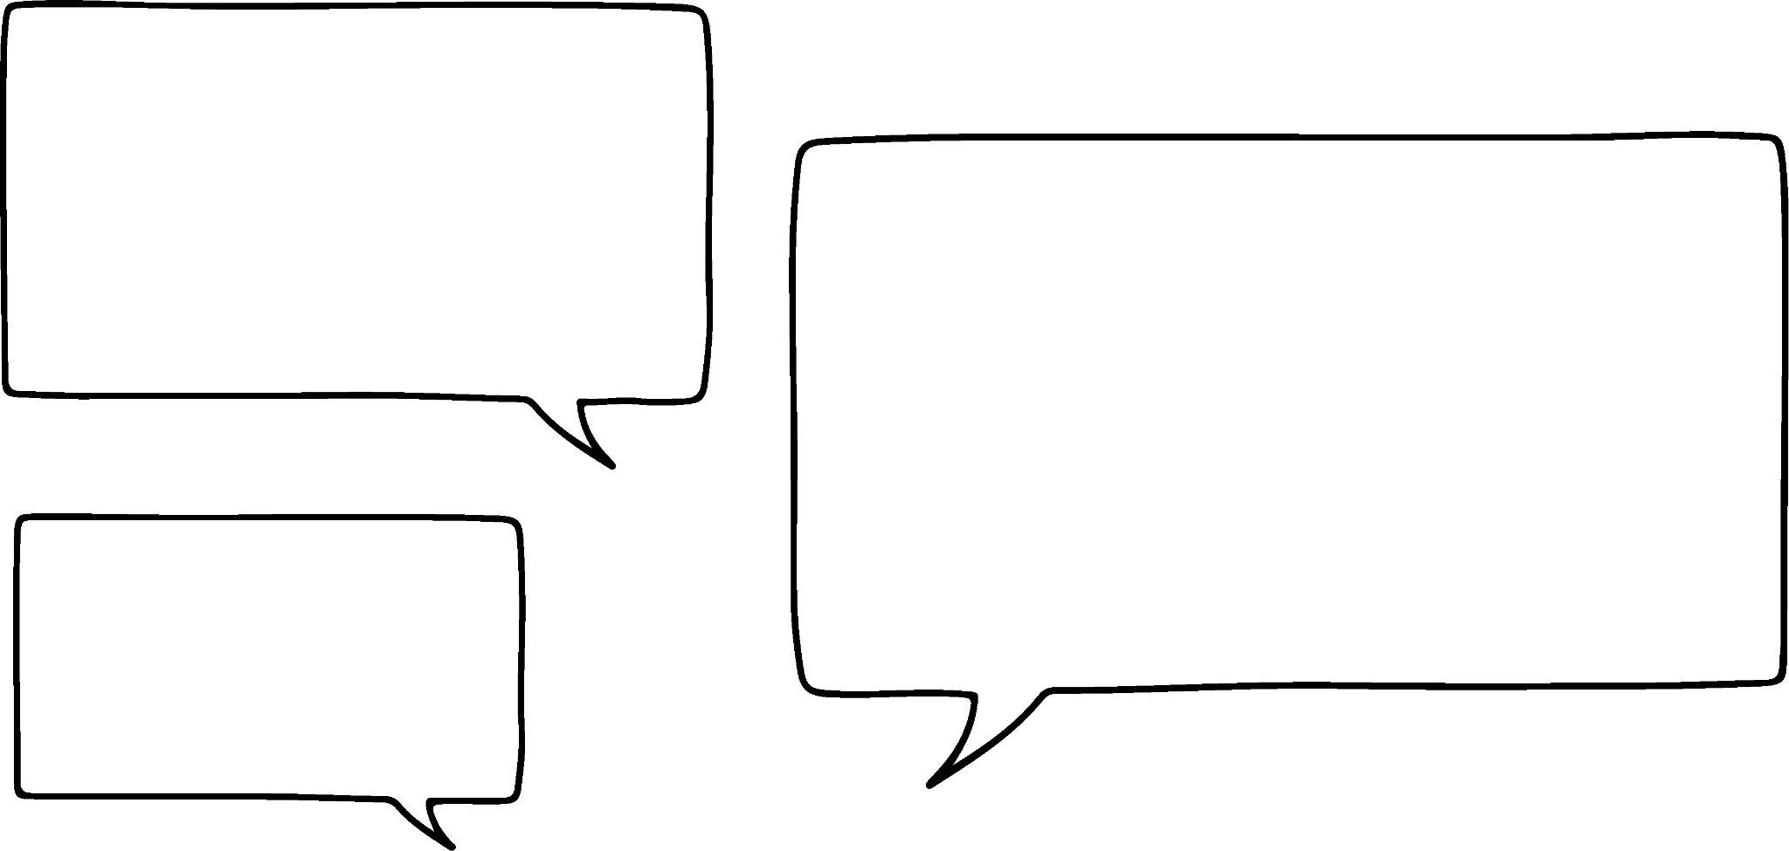
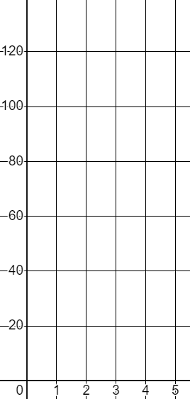


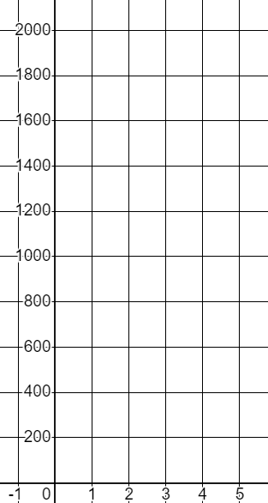

Representing geometric sequences graphically
3) Sam is contemplating the shape of the graphs of geometric sequences.
I don’t know if the starting term affects the shape. If I use the same common ratio of 2 but start on two different numbers will I get a different shape?
T
n | 1 | 2 | 3 | 4 | 5
T | 2
n | 1 | 2 | 3 | 4 | 5
T | 8
Using a common ratio to complete the tables, plot both graphs, and write a conclusion for Sam.
n
Beware, you can only plot the points approximately.
Task B: Graphing a common ratio less than 1
1) a) Complete the table of values and graph this geometric sequence with a common ratio
T
n | 1 | 2 | 3 | 4 | 5
T | 2025
Plot the coordinates as accurately as you can.
n

Slide 3


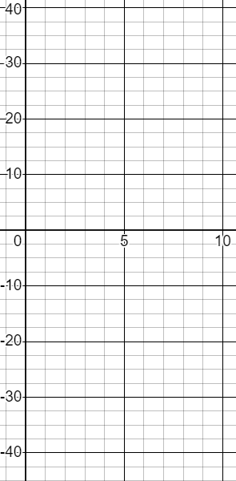
Representing geometric sequences graphically
1) b) Complete the table of values and graph this geometric sequence with a common ratio
T
n | 1 | 2 | 3 | 4 | 5
T | 2025
Plot the coordinates as accurately as you can.
n
2) Complete the table of values and graph this geometric sequence with a common ratio −1.5
T
n | 1 | 2 | 3 | 4 | 5 | 6 | 7 | 8
T | 2.56
×−1.5
n
Plot the coordinates as accurately as you can.
Mathematics in Education and Industry,

